Slide 1
Web based Programming
7. PHP and Web Server Programming

Slide 2
7.1 Origins and Uses of PHP
Origins
      Rasmus Lerdorf – 1994
        Developed to allow him to track visitors to his Web site
    PHP was originally an acronym for Personal Home Page, but later it became PHP: Hypertext Preprocessor
    Form handling, file processing, and database access

Slide 3
7.2 Overview of PHP
    PHP is a server-side scripting language
      scripts are embedded in HTML documents
      Similar to JavaScript, but on the server side
    PHP syntax is similar to that of JavaScript
    PHP is dynamically typed
    PHP is purely interpreted
    http://www.php.net/

Slide 4
7.3 General Syntax
    PHP code can be specified in an HTML document internally or externally:
Internally: <?php
...
?>
Externally: include ("myScript.inc")
Comments - three different kinds (Java and Perl)
// ...
# ...
/* ... */

Slide 5
7.4 Primitives, Operations, and Expressions
Variables
  Every variable name begins with a $
  NO type declarations
  An unassigned (unbound) variable has the value, NULL
    The unset function sets a variable to NULL
    The IsSet function is used to determine whether a variable is NULL
Primitive types:
  Scalar types: Boolean, integer, double, and string
  Compound types: array

Slide 6
7.4 Primitives, Operations, and Expressions
Boolean, Integer & double are like those of other languages
Strings
  String literals use ‘single’ or “double” quotes
  Single-quoted string literals
    Embedded variables are NOT interpolated
  Double-quoted string literals
    Embedded variables ARE interpolated
  $val = 5;
  $string = “It takes $val” (It takes 5);
  $string = ‘It takes $val’ (It takes $val);

Slide 7
7.4 Primitives, Operations, and Expressions
Arithmetic Operators and Expressions
  Usual operators
  If the result of integer division is not an integer, a double is returned
  Any integer operation that results in overflow produces a double
  The modulus operator (%) coerces its operands to integer, if necessary
  When a double is rounded to an integer, the rounding is always towards zero
Arithmetic functions
  floor, ceil, round, abs, min, max, rand, etc.

Slide 8
7.4 Primitives, Operations, and Expressions
String Operations and Functions
  The only operator is period ( . ), for catenation
  Indexing
    $str{3} is the fourth character
strlen, strcmp, strpos, substr, as in C
chop – remove whitespace from the right end
trim – remove whitespace from both ends
ltrim – remove whitespace from the left end
strtolower, strtoupper

Slide 9
7.4 Primitives, Operations, and Expressions
Scalar Type Conversions
  Explicit conversions – casts
- e.g., (int)$total or intval($total) or settype($total, "integer")
  String to numeric
    If the string contains an e or an E, it is converted to double; otherwise to integer
    If the string does not begin with a sign or a digit, zero is used
  The type of a variable can be returned by gettype or is_type
gettype($total) - it may return "unknown"
is_integer($total) – a predicate function

Slide 10




7.5 Output
Output from a PHP script is an HTML document that is sent to the browser
http://www.ntu.edu.sg/xxx.php
HTML documents

Slide 11
7.5 Output
    The PHP processor has two modes:
        copy (HTML) and interpret (PHP)
<html>
<head><title> Trivial php example </title></head>
<body>
<?php
print "Welcome to my Web site!";
?>
</body>
</html>
→ today.php

Slide 12
7.5 Output
HTML is produced through standard output
Two ways to produce output: print and printf
  print takes a string, but will coerce other values to strings
print "This is too <br /> much fun <br />";
print 72;
  printf is the standard output method, exactly the same as in C
printf(literal_string, param1, param2, …)
printf('There are %d monkeys in the %s', $num, $location);

Slide 13
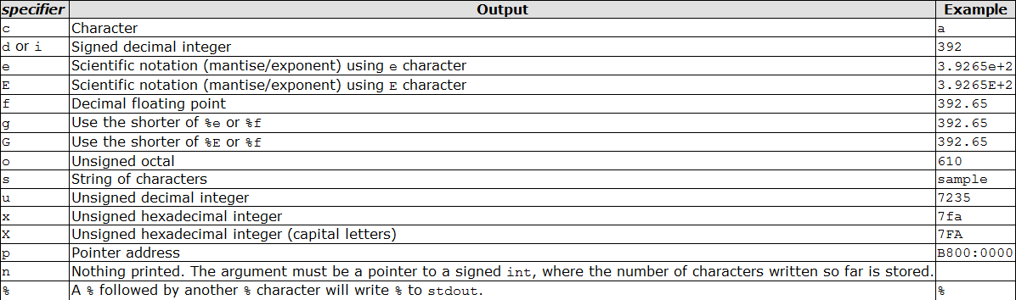
7.5 Output
%specifier

Slide 14
7.6 Control Statements
Control Expressions
- Relational operators - same as JavaScript (including === and !==)
Selection statements
- if, if-else, elseif
- switch - as in C/java
- while - just like C/java
- do-while - just like C/java
- for - just like C/java
- break - in any for, foreach, while, do-while, or switch
- continue - in any loop
- foreach – array operations (will be discussed later)

Slide 15
7.6 Control Statements
- HTML can be intermingled with PHP script
<?php
$a = 7;
$b = 7;
if ($a == $b) {
$a = 3 * $a;
?>
<br /> At this point, $a and $b are equal <br />
So, we change $a to three times $a
<?php
}
?>
→ powers.php

Slide 16
7.7 Arrays
A PHP array is a generalization of the arrays of other languages
- A mapping of keys to values
- The keys can be numbers (to get a traditional array) or strings (to get a hash)
- The value can be anything
Array creation
- Use the array() construct, which takes one or more key => value pairs as parameters and returns an array of them
e.g., $list = array(0 => "apples", 1 => "oranges", 2 => "grapes")
This is a “regular” array of strings

Slide 17
7.7 Arrays
e.g.,
$list = array("make" => "Cessna",
"model" => "C210", "year" => 1960, 3 => "sold");
$list = array(1, 3, 5, 7, 9);
$list = array(5, 3 => 7, 5 => 10, "month" => "May");
If a key is omitted and there have been integer keys, the default key will be the largest current key + 1
If a key is omitted and there have been no integer keys, 0 is the default key
If a key appears that has already appeared, the new value will overwrite the old one

Slide 18
7.7 Arrays
Accessing array elements – use brackets
$list[4] = 7;
$list["day"] = "Tuesday";
- If an element with the specified key does not exist, it is created
- If the array does not exist, the array is created
An array can be deleted with unset
e.g.,
unset($list);
unset($list[4]); # Deletes index 4 element

Slide 19
7.7 Arrays
The keys can be extracted from an array
<?php
$array = array(0 => 100, "color" => "red");
print_r(array_keys($array));
?>
Array ( [0] => 0 [1] => color )

Slide 20
7.7 Arrays
Some other useful functions
- is_array($list) returns true if $list is an array
- in_array(17, $list) returns true if 17 is an element of $list
- sizeof(an_array) returns the number of elements
- explode(" ", $str) creates an array with the values of the words from $str, split on a space
$pizza = "piece1 piece2 piece3 piece4 piece5 piece6";
$pieces = explode(" ", $pizza);
- implode(",", $list) creates a string of the elements from $list, separated by a comma

Slide 21
7.7 Arrays
- foreach (array_name as scalar_name) { ... }
e.g.,
$colors = array(“red”, “blue”, “green”, “yellow”);
foreach ($colors as $color) {
print (“Is $color your favorite color?<br />”);
}
Is red your favorite color?
Is blue your favorite color?
Is green your favorite color?
Is yellow your favorite color?

Slide 22
7.7 Arrays
- foreach can iterate through both keys and values:
foreach ($colors as $key => $color) { … }
Inside the compound statement, both $key and $color are defined, e.g.,
$ages = array("Bob" => 42, "Mary" => 43);
foreach ($ages as $name => $age)
print("$name is $age years old <br />");

Slide 23
7.8 User Defined Functions
Syntactic form:
function function_name(formal_parameters) {
…
}
General Characteristics
- Functions need NOT be defined before they are called
- Function overloading is not supported
- Cannot redefine a function
- Functions can have a variable number of parameters
- Function definitions can be nested

Slide 24
7.8 User Defined Functions
Parameters
- If the caller sends too many actual parameters, the subprogram ignores the extra ones
- If the caller does not send enough parameters, the unmatched formal parameters are unbound
- The default parameter passing method is pass by value (one-way communication)
- To specify pass-by-reference, prepend an ampersand to the formal parameter
function set_max(&$max, $first, $second) {
if ($first >= $second)
$max = $first;
else
$max = $second;
}

Slide 25

7.8 User Defined Functions
Return Values
- Any type may be returned, including objects and arrays, using the return
- If a function returns a reference, the name of the function must have a prepended ampersand
function &newArray($x) { … }
An incorrect use:
function &set_max($first, $second) {
if ($first >= $second)
$max = $first;
else
$max = $second;
return $max;
}

Slide 26
7.9 Pattern Matching
Similar to Javascript
preg_match(regex, str [,array])
preg_match(“/^PHP/”, $str)
The optional array is where to put the matches
preg_match() returns the number of times pattern matches. That will be either 0 times (no match) or 1 time because preg_match() will stop searching after the first match.
preg_match_all() on the contrary will continue until it reaches the end of subject.

Slide 27
7.10 Form Handling
PHP particulars:
- PHP builds an array of the form values
$_POST for the POST method – subscripts are the widget names

Slide 28
7.10 Form Handling
PHP particulars:
- PHP builds an array of the form values
$_POST for the POST method – subscripts are the widget names
→ popcorn3.html
→ popcorn3.php

Slide 29
7.10 Form Handling
PHP particulars:
- PHP builds an array of the form values
$_POST for the POST method – subscripts are the widget names
$_GET for the GET method
Mo’s web site again ☹

Slide 30
7.11 Files
PHP can:
- Deal with any files on the server
- Deal with any files on the Internet, using either http or ftp
- A file has a file pointer (where to read or write)
$fptr = fopen(filename, use_indicator)
Use indicators:
r read only, from the beginning
r+ read and write, from the beginning
w write only, from the beginning (also creates the file, if necessary)
w+ read and write, from the beginning (also creates the file, if necessary)
a write only, at the end, if it exists (creates the file, if necessary)
a+ read and write, read at the beginning, write at the end

Slide 31
7.11 Files
- fopen could fail ( use with exit)
<?php
$filename = '/path/to/data-file';
$file = fopen($filename, 'r')
or exit("unable to open file ($filename)");
?>
- Use file_exists(filename) to determine whether file exists before trying to open
- Use fclose(file_var) to close a file (Don’t forget to close a file after writing into it)

Slide 32
7.11 Files
Reading files
1. Read all or part of the file into a string variable
$str = fread(file_var, #bytes)
- To read the whole file, use filesize(file_name)as the second parameter
2. Read one line from the file
$line = fgets(file_var, #bytes)
- Read characters until eoln, eof, or #bytes- characters have been read

Slide 33
7.11 Files
Reading files
3. Read one character at a time
$ch = fgetc(file_var)
e.g., control reading lines or characters with eof detection using feof (TRUE for eof; FALSE otherwise)
while(!feof($file_var)) {
$ch = fgetc($file_var);
}
4. Read all of the lines of the file into an array
$file_lines = file(file_name)
Need not open or close the file

Slide 34
7.11 Files
Writing to files
$bytes_written = fwrite(file_var, string)
- fwrite returns the number of bytes it wrote
- Files can be locked (to avoid interference from concurrent accesses) with flock

Slide 35
7.11 Files
Files can be locked (to avoid interference from concurrent accesses) with flock
  operation is one of the following:
  LOCK_SH to acquire a shared lock (reader).
  LOCK_EX to acquire an exclusive lock (writer).
  LOCK_UN to release a lock (shared or exclusive).
  <?php
  $fp = fopen("/tmp/lock.txt", "r+");
  if (flock($fp, LOCK_EX)) { // do an exclusive lock
  ftruncate($fp, 0); // truncate file
  fwrite($fp, "Write something here\n");
  flock($fp, LOCK_UN); // release the lock
  } else {
  echo "Couldn't get the lock!";
  }
  fclose($fp);?>

Slide 36
7.11 Files
Files can be locked (to avoid interference from concurrent accesses) with flock
  operation is one of the following:
  LOCK_SH to acquire a shared lock (reader).
  LOCK_EX to acquire an exclusive lock (writer).
  LOCK_UN to release a lock (shared or exclusive).
  LOCK_NB as a bitmask (for non-blocking access)
<?php
$fp = fopen('/tmp/lock.txt', 'r+');
/* Activate the LOCK_NB option on an LOCK_EX operation */
if(!flock($fp, LOCK_EX | LOCK_NB)) {
echo 'Unable to obtain lock';
exit(-1);
}
/* ... */
fclose($fp);?>

Slide 37
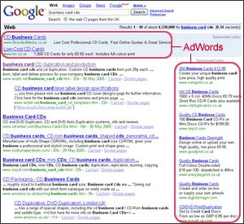


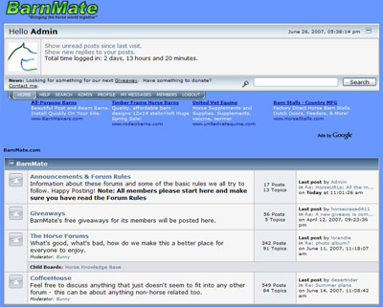
7.12 Cookies
Recall that the HTTP protocol is stateless; however, there are several reasons why it is useful for a server to relate a request to earlier requests

Slide 38
7.12 Cookies
Recall that the HTTP protocol is stateless; however, there are several reasons why it is useful for a server to relate a request to earlier requests
A cookie is a name/value pair that is passed between a browser and a server in the HTTP header
In PHP, cookies are created with setcookie
setcookie(cookie_name, cookie_value, lifetime)
e.g., setcookie(“cookie1", “one", time() + 86400);
- Cookies are implicitly deleted when their lifetimes are over
- Cookies must be created before any other HTML is created by the script
- Cookies are obtained in a script the same way form values are gotten, using the $_COOKIE array

Slide 39
7.12 Cookies
An example of an HTTP response header:
  HTTP/1.1 200 OK
  Date: Tues, 18 May 2004 16:45:13 GMT
  Server: Apache (Red-Hat/Linux)
  Last-modified: Tues, 18 May 2004 16:38:38 GMT
  Etag: "841fb-4b-3d1a0179"
  Accept-ranges: bytes
  Content-length: 364
  Connection: close
  Content-type: text/html, charset=ISO-8859-1
  Set-Cookie: ……

Slide 40
7.12 Cookies
GET /index.php HTTP/1.1
Host: www.example.org
HTTP/1.1 200 OK
Content-type: text/html
Set-Cookie: name=value
Set-Cookie: name2=value2; Expires=Wed, 09-Jun-2021 10:18:14 GMT
GET /spec.php HTTP/1.1
Host: www.example.org
Cookie: name=value; name2=value2
Accept: */*

Slide 41
7.13 Session Tracking
A session is the time span during which a browser interacts with a particular server
For session tracking, PHP creates and maintains a session tracking id
session_start() to create the id
session_register()to register session variables.
Subsequent calls to session_start() retrieves any session variables that were previously registered in the session

Slide 42
7.13 Session Tracking
Count the times of page visits of a same client
For every page:
session_start();
if (!IsSet($page_number))
$page_number = 1;
print("You have now visited $page_number");
print(" pages <br />");
$page_number++;
session_register("page_number");

Slide 43
7.13 Session Tracking
How to implement sessions?
Cookie (setcookie)
Browser =>
GET /cxt/index.php HTTP/1.1
Server =>
HTTP/1.1 200 OK
Set-Cookie: JSESSIONID=3EF0AEC40F2C6C30A0580844C0E6B2E8; Path=/cxt
...

Slide 44
7.13 Session Tracking
How to implement sessions?
URL rewrite
Browser =>
GET /cxt/index.php HTTP/1.1
Server =>
HTTP/1.1 200 OK
...
<form name="form" method="post" action="/sas/Login.php?jsessionid=3EF0AEC40F2C6C30A0580844C0E6B2E8">
...
</form>
…

Slide 45
Find out more about PHP
    http://www.php.net/
    http://sg2.php.net/manual/en/index.php

